Slide 1





Database Performance
Database Performance for Developers
Boris Hristov
Technical Trainers
SQL
Software University
http://softuni.bg

Slide 2


Table of Contents
Database Performance Factors
Query Execution Plans
Table Indexes
Table Partitioning
Performance Troubleshooting
Notes:
-- partitioning?
-- columnstore
-- troubleshooting approach! - baselining

Slide 3





Database Performance Factors
Overview

Slide 4


DB Performance
DB performance depends on many factors:
Hardware
CPU & RAM
Storage, drives, RAID arrays
SSD drives boost I/O performance
Operating system configuration
Services → turn off unused services
Drivers → use high-performance devices drivers
Network configuration → maximize throughput
Virtual memory → pagefile.sys on separate HDD
Notes:
C Drive will always have 6 GB page file in the new operating systems
1.5x the memory

Slide 5


DB Performance (2)
SQL Server version
Hardware limits
Features included
SQL Server configuration
Configure database storage and files
Configure tempdb size and location
Instance level configurations
Not using Microsoft’s defaults ☺

Slide 6

DB Performance (3)
Database design
Schema normalization (3rd & 4th normal form?)
Data types!
Indexes
Constraints
Triggers
Indexed views
Stored Procedures / Functions
Temp tables and table variables

Slide 7


DB Performance (4)
Query tuning
Efficient SQL
Proper index usage
Optimize physical I/O
Stored procedures tuning
Application design
E.g. ORM framework, query efficiency, N+1 query problem, transactions, more…
Notes:
N+1 = ORMs generating selects for every ID like in a loop

Slide 8
Database Performance Factors
DEMO
Notes:
Instance level configurations
Memory
CPU
Compress Backup
Optimize for ad hoc workloads
Max Degree of parallelism
Cost Threshold for Parallelism
Database Configurations
Size
Growth
Options – Auto Options
VLFs
Create a new DB – large
Instant File initialization
Tools to monitor general performance
Profiler
Extended Events

Slide 9

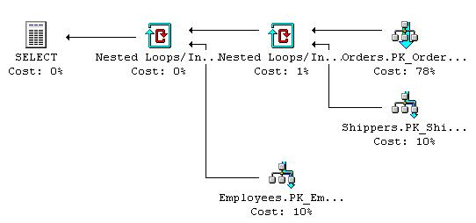
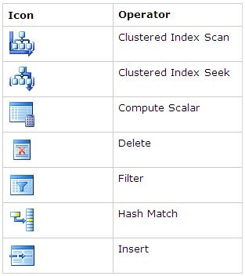



Query Execution Plans
How to Analyze Query Execution Plans?
Notes:
Някъде SQLSentry…

Slide 10
Query Execution Plans
The definition of Query Plan:
How the Query Optimizer decides to execute your query.
Two types of plans:
Estimated
Actual
What plan will be chosen depend on numerous factors!
Plans are also cached for reuse
Notes:
Estimated plans use stats
If stats change (20% update) – new objects are created / schema is changed / indexes are rebuild – plan can be different

Slide 11
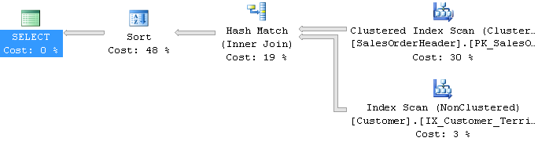
Execution Plan: Example
Consider the following SQL query:
Its execution plan might be as follows:
Read execution plans from right to left and top to bottom!
SELECT c.CustomerID, soh.SalesOrderID, soh.OrderDate
FROM Sales.Customer c JOIN Sales.SalesOrderHeader soh
ON c.CustomerID = soh.CustomerID
WHERE soh.OrderDate > '20040101'
ORDER BY soh.OrderDate DESC

Slide 12

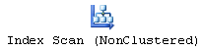
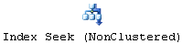
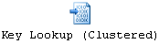
Query Operations
Clustered Index Scan – O(n) operation
Walks through the B-Tree clustered index
The data is sorted by the clustered-index key
Index Scan – O(n) operation
Walks through the B-Tree index
Index Seek – O(log(n)) operation
Similar performance like Clustered Index Seek
Key Lookup – O(1) operation
Finds a table record by its ID (read a record)

Slide 13
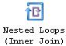
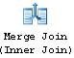
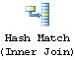
Join Operations
Nested Loops – O (n*m) operation
Nested “for each row…” operation
Merge Join – O (n + m) operation
Scans both sides of join in parallel
Ideal for large range scans
No sort is required when both columns are indexed
Hash Join – O (n + m) operation
“Hashes” the join column/s from one side of join
“Probes” with the other side (the larger)
Notes:
Hash Join is a blocking operator in comparison with the other joins (small table)

Slide 14
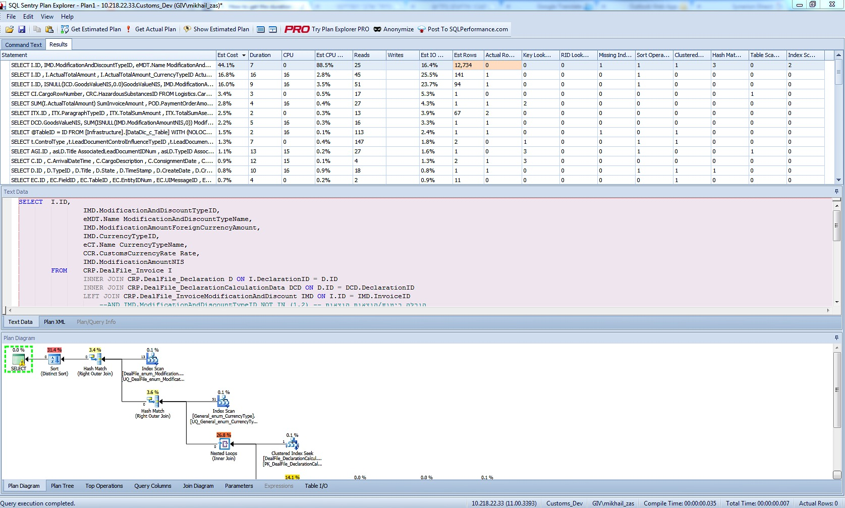
SQL Sentry Plan Explorer (Free)
Notes:
-- How to get the execution plan
-- Estimated
-- Actual
-- How to save the plan with sqlsentry plan explorer
-- All 2.0 scripts

Slide 15
Query Execution Plans
Live Demo

Slide 16

Table Indexes
Clustered and Non-Clustered Indexes

Slide 17
Indexes
Indexes speed up searching of values in a certain column or group of columns
Provide fast data access in log(N) steps
Usually implemented as B-trees
SQL Server 2012 introduces Columnstore indexes!
Insert / update / delete of records in indexed tables is slower!

Slide 18
Clustered Indexes
Clustered index is actually the data itself
An index built-in the table as B-tree – very fast!
Highly recommended for every table!
Very useful for fast execution of WHERE, ORDER BY and GROUP BY clauses
Maximum 1 clustered index per table
If a table has no clustered index, its data rows are stored in an unordered structure (heap)

Slide 19
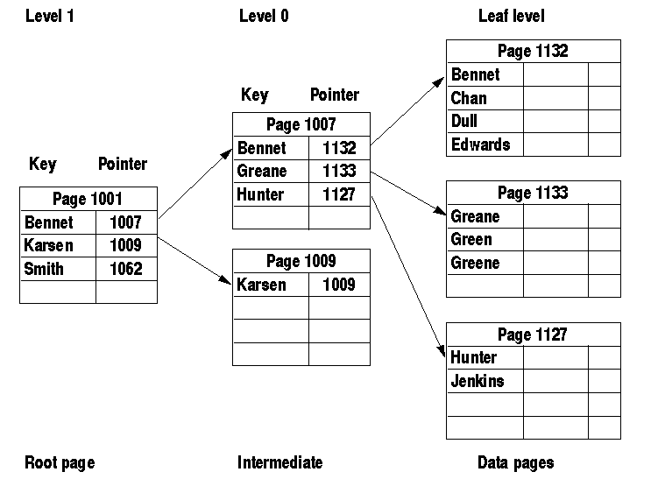
Clustered Index: Structure

Slide 20
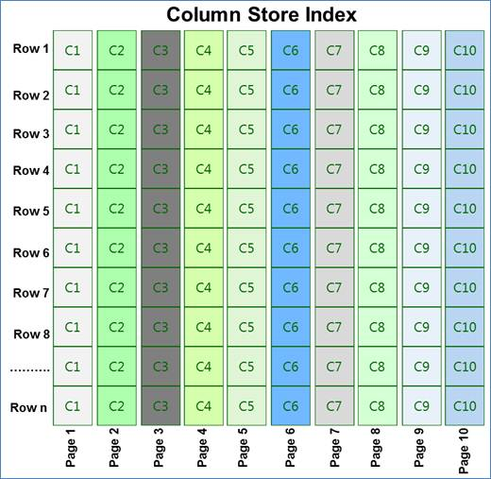
Columnstore Index: Structure

Slide 21
Non-Clustered Indexes
Useful for fast retrieving a single record or a range of records
Maintained in a separate structure in the DB
Tend to be much narrower than the base table
Can locate the exact record(s) with less I/O
Has at least one more intermediate level than the clustered index
Much less valuable if table doesn’t have a clustered index

Slide 22
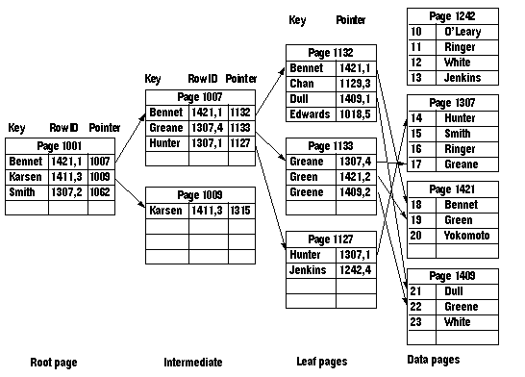
Non-Clustered Index: Structure

Slide 23
Add Index When
You need fast access by some column or group of columns
Unless the records are less than 1 000
Search by certain column/s (WHERE clause)
Data within the column is used to build joins
Foreign keys are almost always good candidates for indexes
You need to scan large table fast – Columnstore!

Slide 24
How Many Indexes?
Adding non-clustered indexes to a table can greatly speed-up SELECT statements
Every index has a certain amount of overhead
The greater the number of indexes, the more overhead with every INSERT, UPDATE, and DELETE statements
Must balance the needs of the application with the pros and cons of added indexes
OLTP → less indexes (more modify, less read)
Online Transaction Processing (Standard DB)
OLAP → more indexes (more read, less modify)
Online Analytical Processing (Data Warehouse)
Notes:
Any time you rebuild the clustered index, you also automatically rebuild all non-clustered indexes on the table.

Slide 25
Fill Factor
When SQL Server creates indexes, every page is nearly 100% full
No room on the leafs or intermediate pages for INSERTs, UPDATEs, or DELETEs
The default (100%) can cause costly page splits on certain tables
Promotes table fragmentation
You can specify amount of free space in leaf and intermediate pages with FILLFACTOR and PADINDEX (prefer 75-80%)
An option in the CREATE INDEX
Small FILLFACTOR may cause performance issues – bigger pages = more data in cache
Notes:
Can set FILL FACTOR at a server level or specify with each clustered index.
A good rule of thumb setting is 75-80%
Should not set at the server level since some tables perform worse with fill factor of less than 100%.
Naturally, this option strongly affects the amount of space that a table and its indexes will consume. However, disk is cheap!

Slide 26
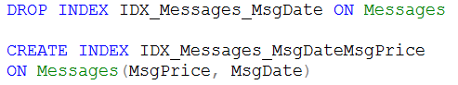
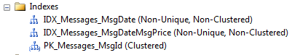
Table Indexes
Live Demo
Notes:
Database Instance – Fill Factor
All 3.0 demos + 4.0

Slide 27
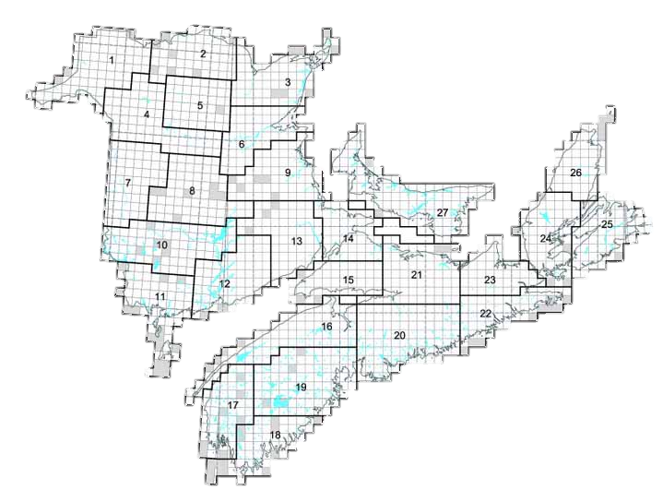


Table Partitioning
Overview

Slide 28
Why is partitioning cool?
Partitioning is a physical split of a large table into several pieces by some criteria
Numbers
0
…
8000
Partition 1
0
…
2500
Partition 1
0
…
2500
Partition 1
0
…
2500
Partition 2
2501
…
4000
Partition 3
4001
…
8000

Slide 29

Why is partitioning cool? (2)
Partition 1
0
…
2500
FG1
Numbers
0
…
8000
Numbers
2501
…
4000
FG2
Numbers
4001
…
8000
FG3

Slide 30
Partitioning in SQL Server
Live Demo

Slide 31
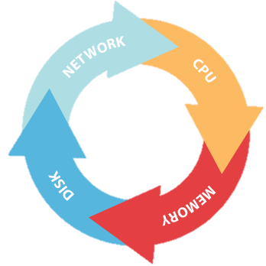

Performance Troubleshooting
The Algorithm

Slide 32
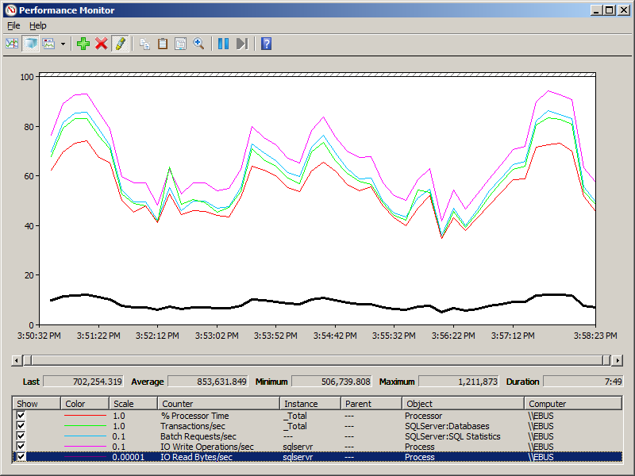
Prerequisite before troubleshooting
Baselining!
Collect and Store Performance Data
Performance Monitor
SQL Server DMVs
System information
Ask the user –Was the performance OK today?
If yes – save the information!
Every time there is a performance problem – collect the same data and compare!

Slide 33
The correct approach to performance issues
Hardware
OS
SQL Server
Query

Slide 34
Performance Troubleshooting
The Algorithm

Slide 35


Summary
Database Performance Factors
Query Execution Plans
Table Indexes
Table Partitioning
Performance Troubleshooting
Databases

Slide 36







Databases
https://softuni.bg/courses/databases

Slide 37
License
This course (slides, examples, demos, videos, homework, etc.) is licensed under the "Creative Commons Attribution-NonCommercial-ShareAlike 4.0 International" license
Attribution: this work may contain portions from
"Databases" course by Telerik Academy under CC-BY-NC-SA license

Slide 38





Free Trainings @ Software University
Software University Foundation – softuni.org
Software University – High-Quality Education, Profession and Job for Software Developers
softuni.bg
Software University @ Facebook
facebook.com/SoftwareUniversity
Software University @ YouTube
youtube.com/SoftwareUniversity
Software University Forums – forum.softuni.bg

